Slide 1
EMOTION RECOGNITION BASED ON ELECTROCEPHALOGAPHY (EEG) SIGNALS
A THESIS SUBMITED BY: TEA MALASI

Slide 2
Table of contents
01
02
03
04
05
06
Introduction
Emotion Characterization
Human Brain Anatomy
EEG in Emotion Recognotion
07
08
Literature Review
Methodology
Results
Conclusion

Slide 3
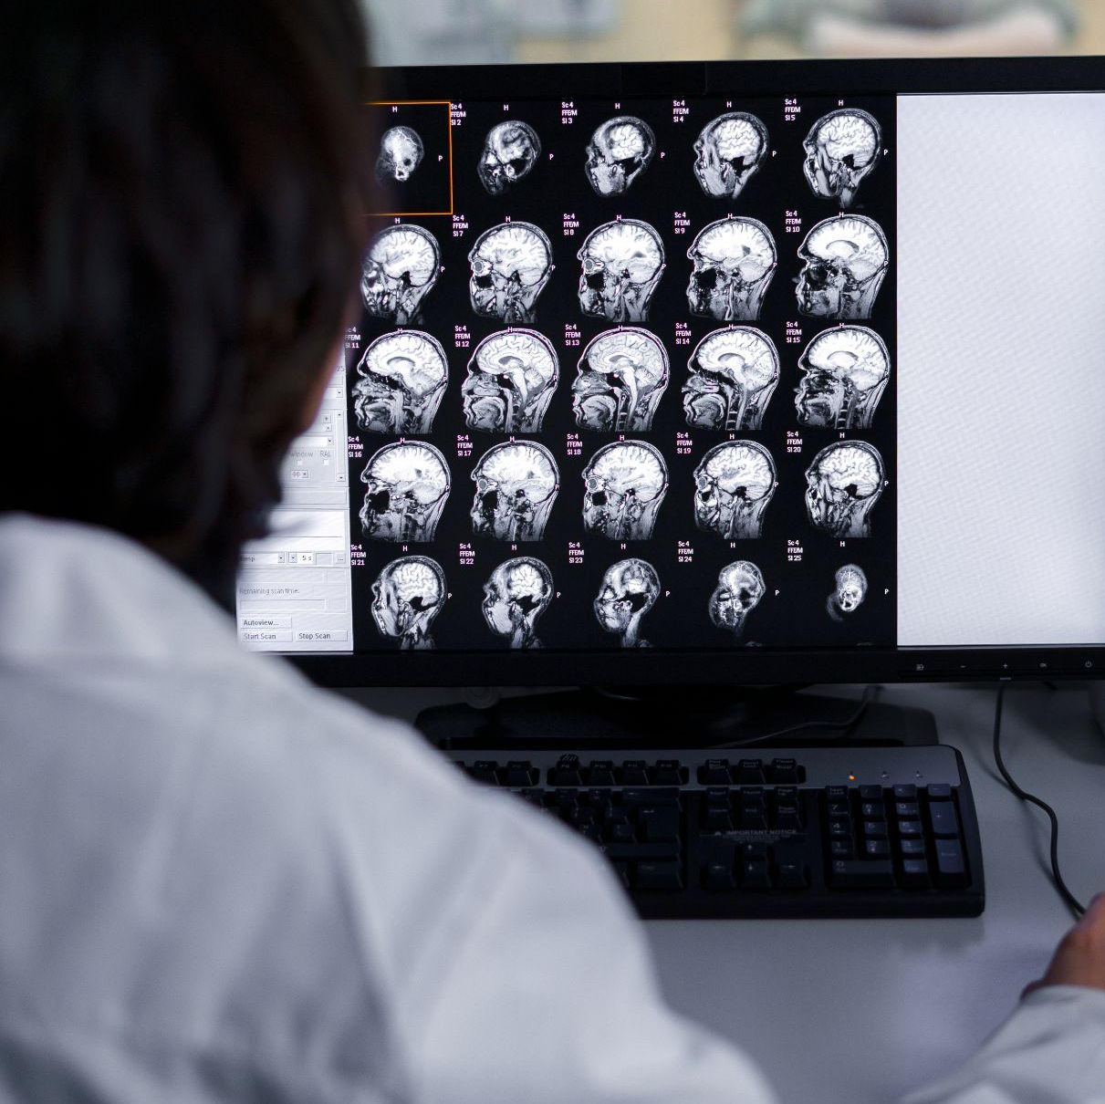
Introduction
Human emotions form the core of our existence, shaping our perceptions, decisions, reactions, feelings, and interactions with the world. Knowing that they are a crucial element of us, that sometimes we can control and sometimes not, makes their study not only a journey into the depths of our psyche but also a crucial exploration for unraveling the complexities of human behavior and fostering deeper understanding within our society.
Why is it important?
Improving what we call human-computer interaction,
It is a big step in the applications of healthcare.

Slide 4
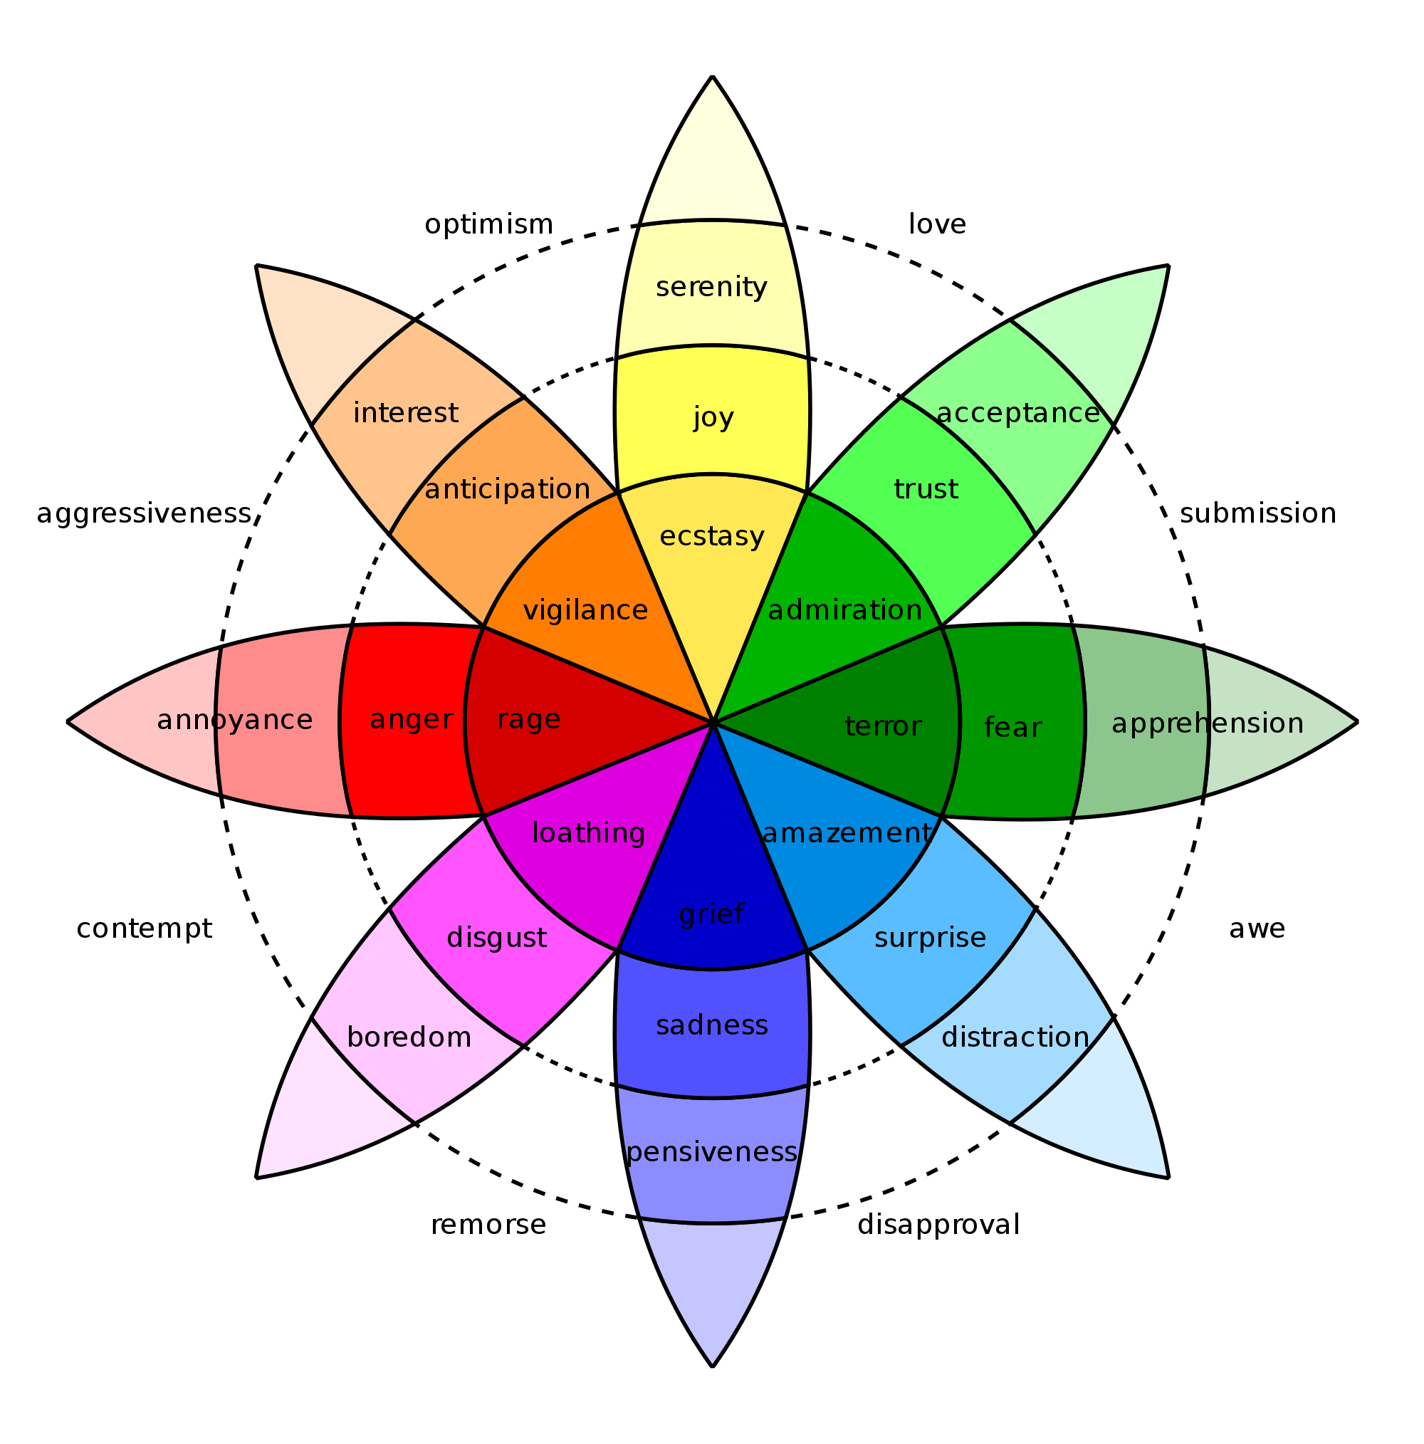
Emotion Characterization
Discrete Emotion Models
Multi-Dimensional Emotion Models
Discrete emotion models categorize emotions into distinct categories like happiness, sadness, and anger. This model offers a simplified and intuitive structure for comprehending emotional experiences. The wheel of emotions made in 1989, is still used in discrete emotion models.
In contrast, multi-dimensional emotion models acknowledge the intricate nature of emotions. They consider factors such as valence, arousal, and dominance, in order to provide a more sophisticated understanding of emotional states and their interrelationships.
Two different kinds of emotional spaces exist in multi-dimensional space:
Two-dimensional (2D) spaces,
Three-dimensional (3D) spaces.

Slide 5
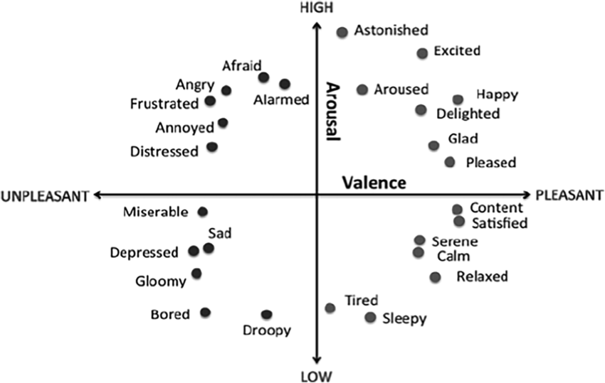
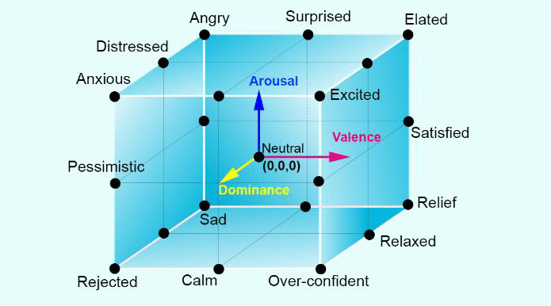
Multi Dimensional Emotions
Two Dimensional (2D) Space
Three- Dimensional (3D) Space
Emotions in 2D space can be classified according to their valence and arousal. The degree of either happy or negative emotions following emotional perception is measured by valence. Arousal identifies passive or active emotional states.
Further elaborating on this, Mehrabian and Russell created a 3D emotion model, incorporating the VAD (valence, arousal, and dominance) dimensions. The third dominating axis in this mode, represents human control or power in a certain emotional state.

Slide 6
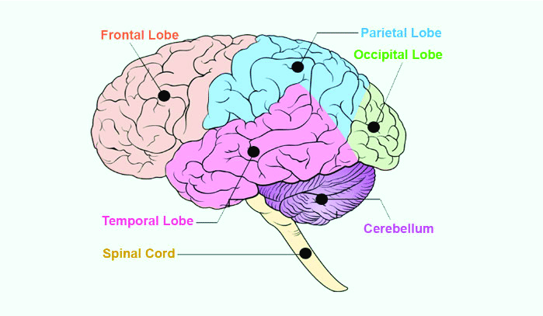
Human Brain Anatomy
The cerebrum, the cerebellum, and the brainstem are the three main components of the brain. Out of the three, the cerebrum is the largest and is separated into the left and right hemispheres. Each cerebral hemisphere is made up of four distinct lobes: the frontal, parietal, temporal, and occipital, which play essential roles contributing to the brain’s intricate functionality.

Slide 7
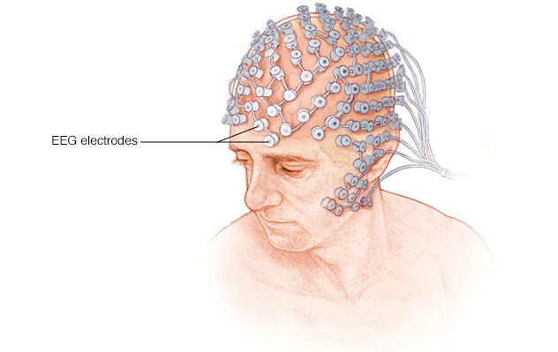
EEG in Emotion Recognition
With the use of electrodes, EEG is the most widely used brain-imaging technique for assessing electrical activity in the brain. The majority of EEG acquisition hardware is in the form of a cap or headset with different connected and wireless electrodes or sensors attached. In order to improve contact, these electrodes are designed to be applied to the surface of the skull or even the cortex using conductive gel and abrasion.
Five major electrical patterns or waves, alpha (α), theta (θ), beta (β), delta (δ), and gamma (γ), can be produced by the human brain. These waves combine to form an EEG signal, which allows us to identify the emotions.

Slide 8
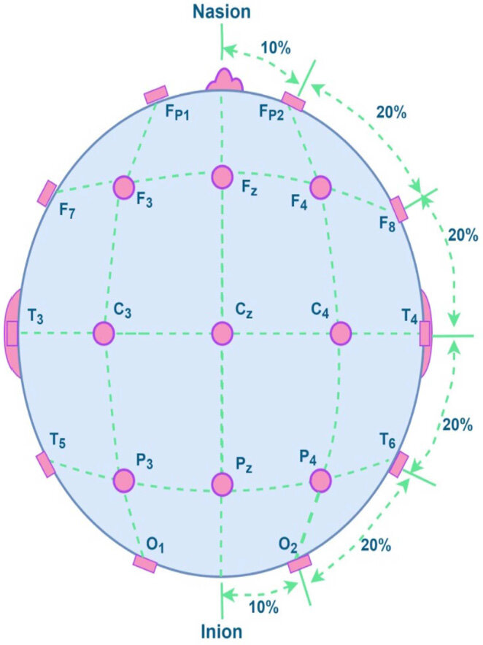
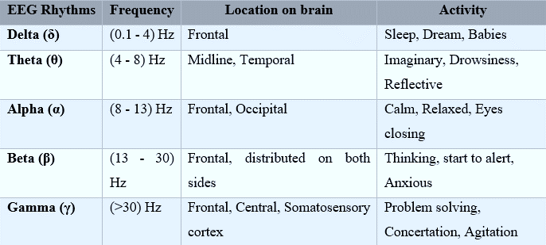
10/20 Placement
The International 10/20 electrode placement scheme is commonly used for emotion recognition. The symbol "10/20" designates a 10% or 20% gap between neighboring electrodes positioned on the scalp.
EEG and Human Brain Connection

Slide 9
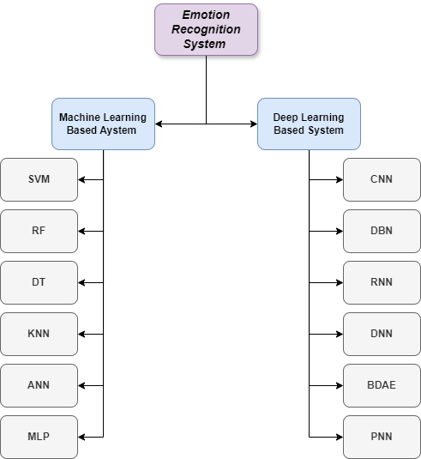
Literature Review
Datasets
Methods used for Emotion Recognition
There are several databases that have been used for emotion recognition in which we can mention:
DEAP database
SEED dataset
DREAMER
MAHNOB HCI
Metrics
The different performance metrics used are accuracy, precision, true positive rate/recall, false positive rate, f1 measure, kappa score, area under curve, confusion matrix.

Slide 10
METHODOLOGY

Slide 11
Datasets used in this research
DREAMER Dataset
The cell DREAMER.Data{i} contains the data for the ith participant and is structured as follows: struct with fields:
• Age: 'X’
• Gender: 'X' ('male' or 'female')
• EEG: [1×1 struct]
• ECG: [1×1 struct]
• ScoreValence: [18×1 double]
• ScoreArousal: [18×1 double]
• ScoreDominance: [18×1 double]
In this dataset we have the recordings of 23 participants along with their ratings of the valance, arousal and dominance after each stimulation. The Emotiv EPOC wireless EEG headset was used to acquire the signals. The participants used a five- point rating scale to indicate how they felt their emotional responses to be.
Structure of the “DREAMER” variable i is a s follows:
• Data: {1×23 cell}
• EEG_SamplingRate: 128
• ECG_SamplingRate: 256
• EEG_Electrodes: {'AF3' 'F7' 'F3' 'FC5' 'T7' 'P7' 'O1' 'O2' 'P8' 'T8' 'FC6' 'F4' 'F8' 'AF4’}
• noOfSubjects: 23
• noOfVideoSequences: 18
DREAMER.Data{i}. EEG is structured as follows :
• Each cell "baseline{i}" contains the data for the neutral clip shown before the ith film clip.
• Each cell "stimuli{i}" contains the data for the ith film clip stimulus.

Slide 12
Data Preprocessing
Baseline- Stimulus
Ratio Calculation
Power Spectral
Density Calculation
This normalization process enhances
the interpretability of the results,
providing valuable insights into the
neural responses to different stimuli.
PSD measures the power of each
frequency component within the
signal, which is essential for
understanding the distribution of
power across different frequency bands.
Bandpass Filtering
Scaling
Feature Normalization
The overall goal of the bandpass filter
is to isolate the important frequency
components by eliminating high
frequency noise and low-frequency
drift.
A crucial preprocessing procedure
used in deep learning techniques to
standardize the range of features or
independent variables in the data
After extracting the features, we
normalized them using standard
scaling to make sure every feature
adds the same amount to the analysis.

Slide 13
Feature Extraction
Frequency Domain
Time Domain
In order to sample a signal without aliasing, we first applied bandpass filters to extract out specific EEG frequency bands, which are: delta, which has a frequency of 0.5–4Hz; theta, which has a frequency of 4–8Hz; alpha, which is 8-13Hz; beta, which is 13–30Hz; and gamma, which is up to 64Hz because our data sampling rate is 128Hz. This is because, according to the Nyquist theorem, the sampling frequency must be at least twice that of the highest frequency on the signal.
We have focused on extracting statistical features from the time domain signals of EEG data. These features summarize the distribution and shape of the signals over time, providing insights into the underlying characteristics of the EEG data. These features were computed for both the baseline and stimulus periods. There are different examples of time domain statistical features but what we have used are the mean, kurtosis, skewness, standard deviation.

Slide 14
Machine Learning Methods Used in this Study
Decision Tree
Support Vector Machine
The best hyperparameters for the Decision
Tree model were identified using grid search
cross-validation, experimenting with various
values for maximum tree depth, minimum
samples to split a node, and minimum
samples at a leaf node to achieve the highest
accuracy.
In this work, a grind search cross- validation
was used to apply the SVM model. We were
able to test many combinations of
hyperparameters in this procedure, including
our kernel type, the kernel coefficient (gamma),
and the regularization parameter (C).
Random Forest
K-Nearest Neighbor
Grind search cross-validation was employed for
the RF as well. We experimented with a variety
of factors, including the total number of trees in
the forest, the tree's maximum depth, the
minimum number of samples needed at each
leaf node, and the minimum number of samples
needed to split a node.
We performed parameter optimization,
examining several values of k to
determine the ideal number of neighbors,
in order to determine the best choice for k.

Slide 15
Deep Learning Methods used in this Study
Recurrent Neural Network
Conventual Neural
Networks
Deep Neural Network
This work built a specific
RNN architecture using
Long Short-Term Memory
(LSTM) units. In order to
optimize the RNN model’s
performance we explored
a variety of configurations,
including varying numbers
of LSTM layers, dropout
rates, and activation
functions.
A 1D CNN architecture was used
in this work. different kernel sizes
and numbers of filters were
tested in the convolutional layers
in an effort to capture the various
degrees of abstraction present in
the input data.
The DNN model architecture
employed in this study consisted
of densely connected layers.
Diverse configurations of hidden
layers and activation functions
were explored to identify the
optimal architecture tailored to
our experiments.

Slide 16
Accuracy
Precision
Recall
F1-score
Metrics used in this Study
To facilitate our comparison, I have created individual Excel tables for each experiment, documenting their results. Additionally, for some of the experiments, I generated charts based on the results tables.

Slide 17
Results
Our experiments comprised the following categories;
Frequency domain results on Machine Learning Algorithms.
Time domain results on Machine Learning Algorithms
Frequency domain results on Deep Learning Algorithms
Time domain results on Deep Learning Algorithms,
It is worth mentioning that for each one of these we have done binary classification (0 and 1) and ternary classification (0, 1 and 2) for classifying valence, arousal and dominance all separate from each other. So in total we have 24 experiments.

Slide 18
Results
The best results for our categories:
For Frequency domain results on Machine Learning Algorithms with binary classification the best results were for arousal with and accuracy of 93,82,87,83 for RF, SVM, DT and KNN respectively.
For Frequency domain results on Machine Learning Algorithms with ternary classification the best results were again for arousal with and accuracy of 86,76,78 for RF, SVM and KNN respectively, but dominance had the best result for DT with the value of 81.
For Time domain results on Machine Learning Algorithms with binary classification the best results were for arousal with and accuracy of 94,87,90, 78 for RF, SV, DT and KNN respectively.
For Time domain results on Machine Learning Algorithms with ternary classification the best results were for dominance with and accuracy of 84,82,76, 80 for RF, SV, DT and KNN respectively

Slide 19
Results
For Frequency domain results on Deep Learning Algorithms with binary classification the best results were for dominance with and accuracy of 89,78,77 for CNN, DNN and RNN respectively.
For Frequency domain results on Deep Learning Algorithms with ternary classification the best results were for arousal with and accuracy of 73,63 for CNN and DNN respectively, but for RNN they were for dominance with the value of 63.
For Time domain results on Deep Learning Algorithms with binary classification the best results were for dominance with and accuracy of 90,84,76 for CNN, DNN and RNN respectively.
For Time domain results on Deep Learning Algorithms with ternary classification the best results were for dominance with and accuracy of 72,63,30 for CNN, DNN and RNN respectively.

Slide 20
Conclusion
This thesis explored deep learning and machine learning methods to identify emotions from EEG signals in the DREAMER dataset. Frequency domain features were generally more effective than time domain features, especially with deep learning models, but their results with machine learning were higher than those with deep learning. This highlights the complexity of emotion recognition tasks and suggests future research could focus on hybrid models and advanced deep learning architectures for better EEG-based emotion recognition.

Slide 21
THANK YOU FOR YOUR ATTENTION!

